Slide 1
Deep Learning Course
TASK 0
M.Jamaluddin

Slide 2
What is deep Learning
Definition: A subset of machine learning involving neural networks with three or more layers.
Inspiration: Mimics the human brain's neural networks.
Key Components:
Neurons (units)
Layers (input, hidden, output)
Weights and biases
Training: Uses large datasets and backpropagation to learn patterns.
Applications:
Image and speech recognition
Natural language processing
Autonomous vehicles

Slide 3

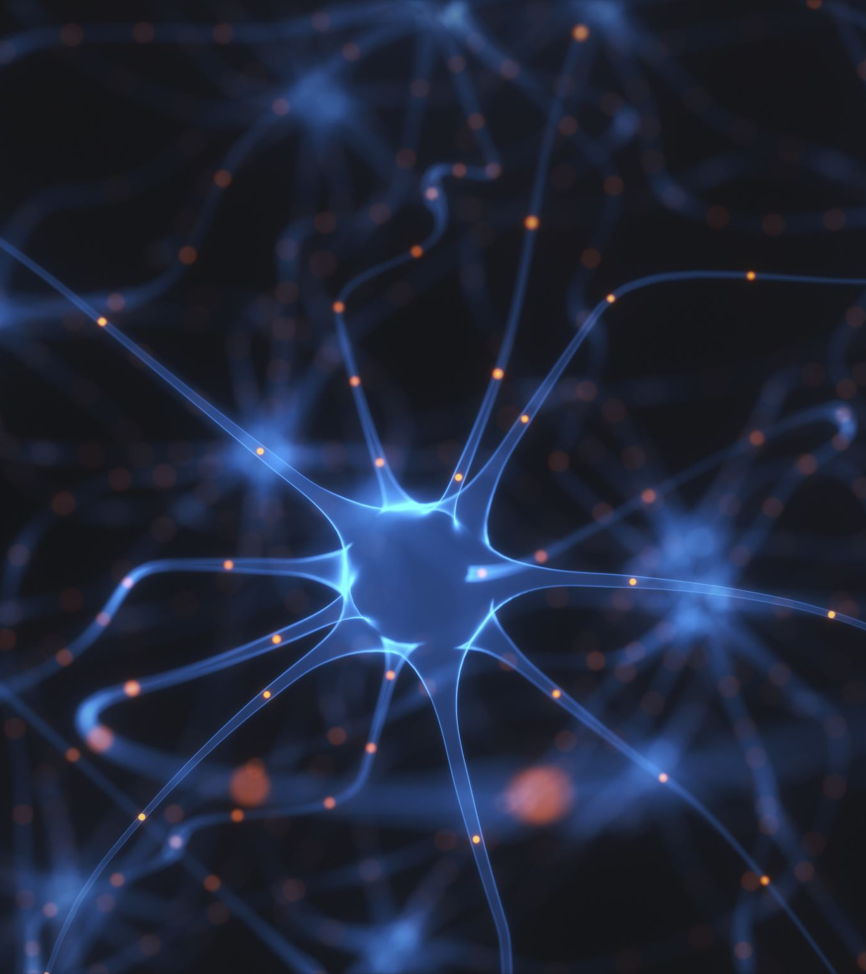

Artificial Neural Network

Slide 4
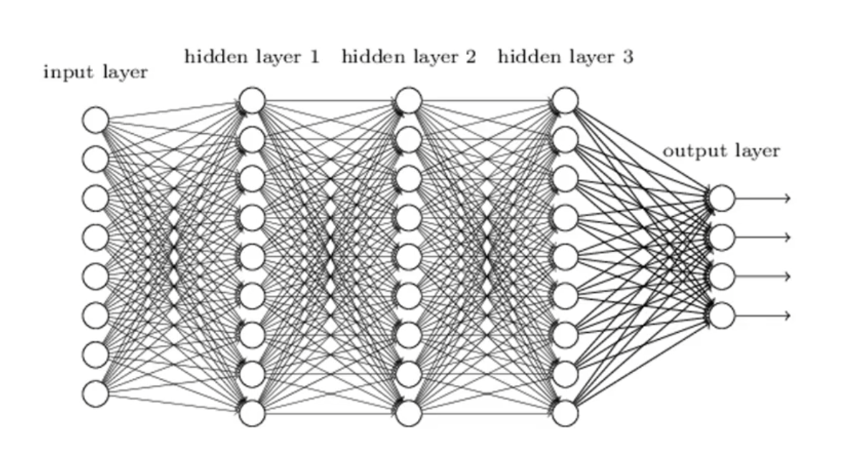
A simple ANN Model
The Model contains an input layer which basically gives the independent variables as inputs to the hidden layers
The hidden layers have activation functions
The output layers gives the prediction or the dependent variable

Slide 5
Activation function
Definition: A mathematical function applied to a neural network's output to introduce non-linearity and enable learning of complex patterns.
Purpose: Helps the network to learn and model complex data patterns and make accurate predictions.
4 main types: Threshold, Rectifier, Hyperbolic Tangent and Sigmoid
The most commonly used is The Rectifier function as it is said to be the most optimal

Slide 6
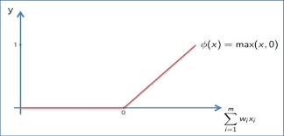
Rectifier Activation Function
This is the most commonly used for the hidden layers

Slide 7
Gradient Descent
Definition: An optimization algorithm used to minimize the loss function in machine learning models by iteratively adjusting model parameters.
Purpose: To find the optimal set of weights and biases that reduce prediction errors.
Key Points
Loss Function: Measures the difference between the predicted and actual values.
Gradient: The slope of the loss function, indicating the direction of the steepest ascent.
Iterations: The process of repeatedly adjusting the parameters until the minimum loss is achieved.

Slide 8
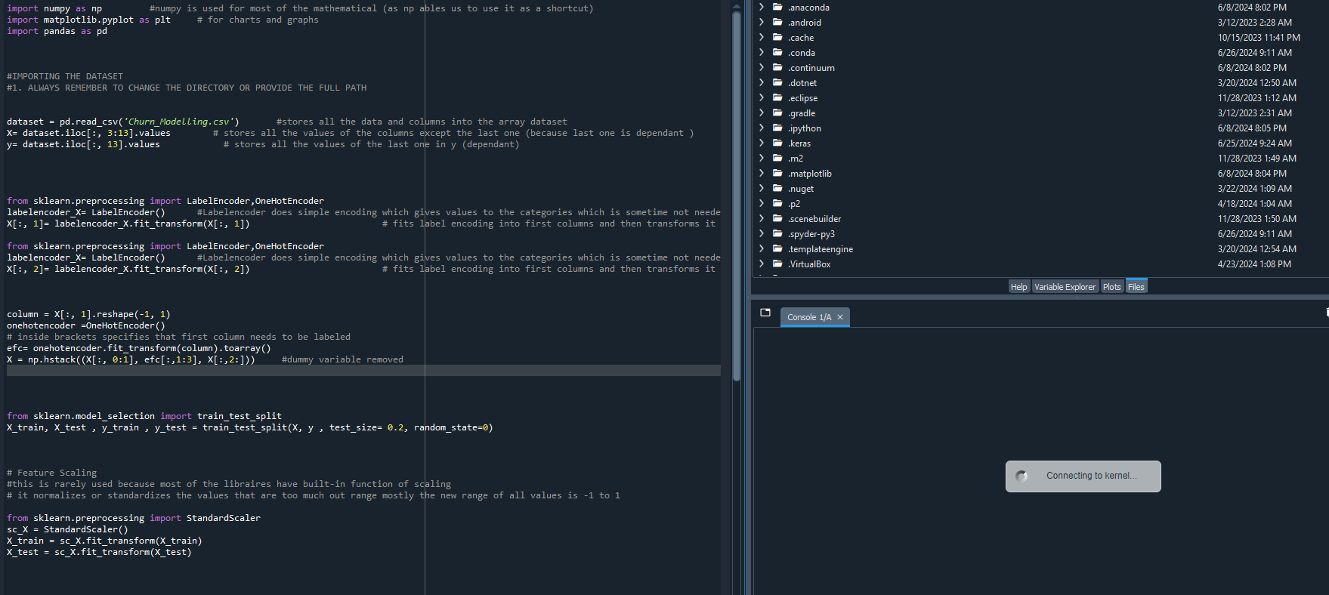
Implementation

Slide 9
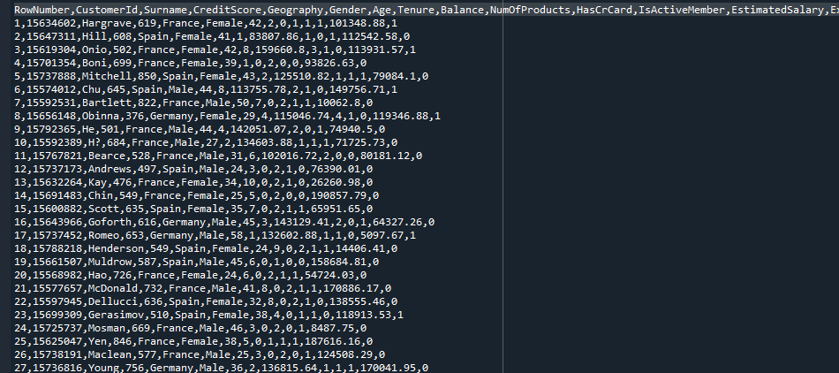
The Dataset
Description: The dataset contains customer information for a bank, including various features used to predict whether a customer will churn (i.e., leave the bank).

Slide 10
Independent Variables
The Dependent variable that was required to be predicted was whether the Customer exited or not
CreditScore: Credit score of the customer.
Geography: Customer's location.
Gender: Customer's gender.
Age: Customer's age.
Tenure: Number of years the customer has been with the bank.
Balance: Customer's account balance.
NumOfProducts: Number of products the customer has with the bank.
IsActiveHasCrCard: Whether the customer has a credit card.
Member: Whether the customer is an active member.
EstimatedSalary: Customer's estimated salary.

Slide 11
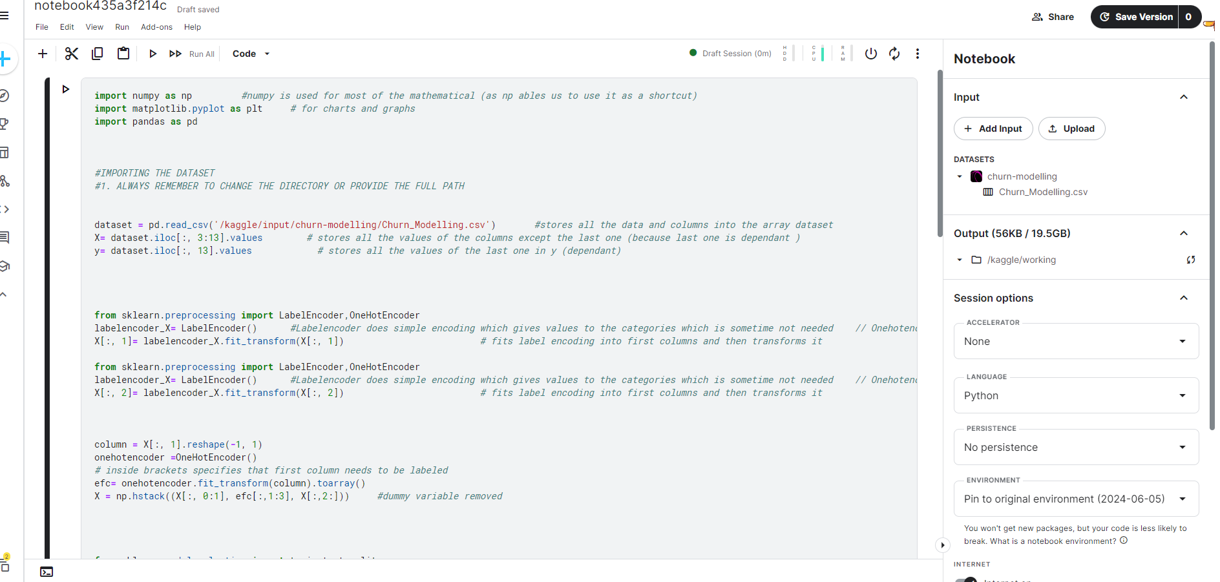
Code

Slide 12
Important Libraries
TensorFlow
An open-source machine learning framework developed by Google, designed for efficient handling of large datasets and complex models.
Provides tools for visualization (TensorBoard), deployment (TensorFlow Serving), and mobile support (TensorFlow Lite).
Keras
A high-level neural networks API in Python that simplifies the creation and training of deep learning models.
Integrated with TensorFlow, offering an easy-to-use interface while leveraging TensorFlow's capabilities.

Slide 13
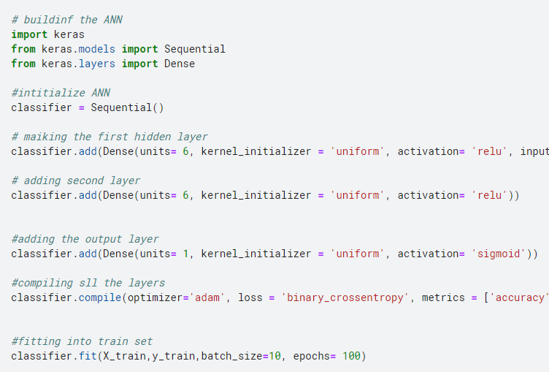
Creating and compiling the layers
The input layer dimensions are defined in the first layer
Then two hidden layers are created with the Rectifier activation function
The output layer has the sigmoid function because the output has two classes and is not continuous

Slide 14
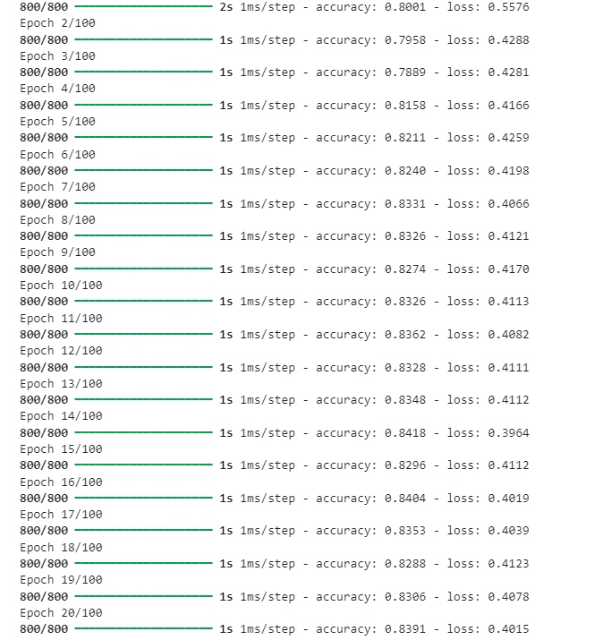
Model Training
The Model was trained for 100 Epochs
Binary cross Entropy function was used as the loss function as the output was binary

Slide 15
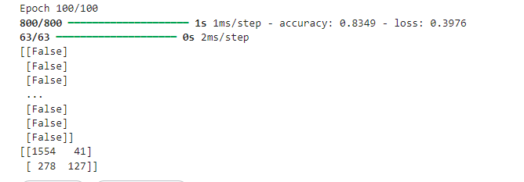
Results Obtained
An accuracy of 83.49% was achieved after training the whole model
The confusion matrix shows that there were 1681 correct predictions and 319 incorrect

Slide 16
Convolutional Neural Network

Slide 17
Definition: A Convolutional Neural Network (CNN) is a deep learning model primarily used for processing structured grid data like images.
Key Components:
Convolutional Layers: Apply filters to input data to detect features.
Pooling Layers: Downsample data to reduce dimensionality and computation.
Fully Connected Layers: Combine features to classify or predict outcomes.

Slide 18
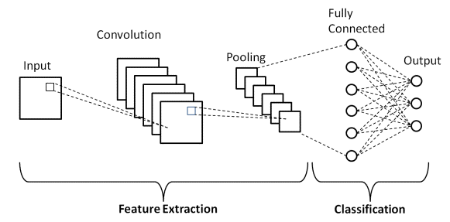
A Simple CNN Model
The Feature Extraction Part does all the image processing required for the model
And the classification part is basically a simple ANN that classifies the images

Slide 19
Convolution and Pooling
Convolution
Definition: A process where a filter (kernel) is applied to input data (such as an image) to extract important features.
Function: Detects patterns like edges, textures, and shapes by sliding the filter over the input and computing dot products.
Pooling
Definition: A downsampling operation that reduces the dimensionality of the data while retaining important features.
Types:
Max Pooling: Takes the maximum value from each region of the input.
Average Pooling: Takes the average value from each region of the input.

Slide 20
Implementation

Slide 21
The Dataset
The Dataset Contained 10000 images of cats and dogs
The training set contained 8000 images in total, 4000 of cats and 4000 of dogs which were separated in folders so that the model can easily classify the images
The test set was also done in the same manner with 1000 images of each

Slide 22
Code

Slide 23
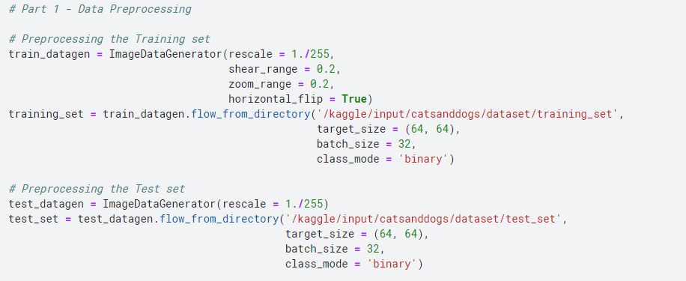
Preprocessing the images

Slide 24
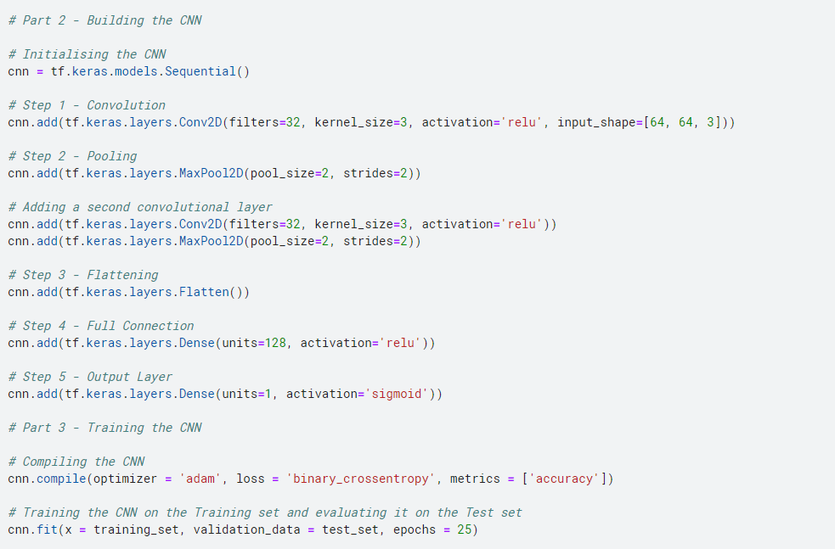
Making the convolutional layer
Two convolutional layers were added for more accurate results as more features will be tested
Increasing the filter size at each layer is a common practice but it would take hours to train the model
The full connection part makes the ANN for classification

Slide 25
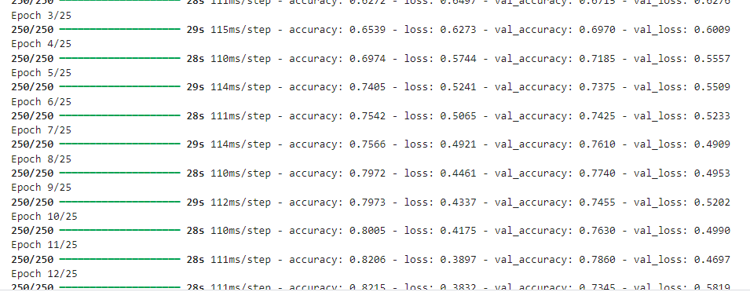
Training the model
The model was trained for 25 epochs
Gpu was used for training the model on Kaggle using its cloud feature

Slide 26
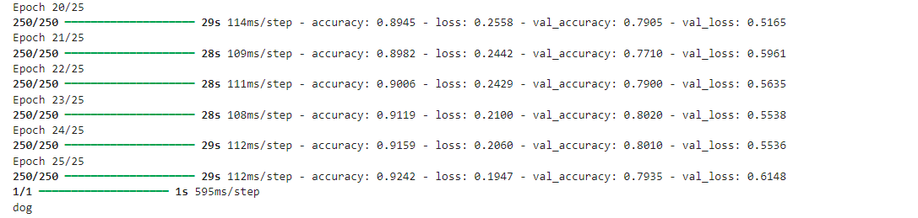
Results Obtained
An accuracy of 92% was obtained on the training set
An accuracy of 79% was obtained on the test set
This difference can be decreased by increasing the number of convolution and pooling layers

Slide 27
Conlusion
Deep Learning: Utilizes neural networks with multiple layers to learn from large datasets, enabling complex pattern recognition and predictions.
ANN Models: Predict outcomes by learning from features, exemplified by predicting customer churn using bank data.
CNNs: Specialize in image processing, using convolution and pooling layers to detect features and reduce data dimensionality.

